Slide 1
Newmark Property Investment Analysis
Data-Driven Insights to Identify High-Growth ZIP Codes

Slide 2
Executive Summary
Objective: Identify the top 10 ZIP codes for property investment using geospatial and statistical modeling.
Key Insights:
High-growth ZIP codes identified with predictive modeling.
Hidden investment gems discovered through spatial analysis.
Geographic influence confirmed using spatial statistics (Moran’s I, Hot Spot Analysis).
Business Impact: Data-backed strategy for high-return property investments.

Slide 3
Business Questions
Where to Invest?
Which 10 ZIP codes show the highest growth potential?
Why These ZIP Codes?
What economic and geographic factors drive their growth?
Geospatial Influence:
How do neighboring ZIP codes impact property values?

Slide 4
Methodology Overview
Data Collection & Cleaning
Census data (2012–2018) covering demographics, housing, and income.
Removed invalid data (missing values, outliers).
Exploratory Data Analysis (EDA)
Identified key trends, correlations, and data distributions.
Predictive Modeling (Random Forest)
Bayesian Optimization for hyperparameter tuning.
Performance Metrics: RMSE, R².
Geospatial Analysis
Moran’s I (spatial autocorrelation).
Hot Spot Analysis (Getis-Ord Gi*).
Combined geospatial and predictive insights.

Slide 5
Predictive Model Performance
Model Used: Random Forest Regressor
Chosen for robustness and handling of non-linear relationships.
Bayesian Optimization improved accuracy.
Model Evaluation:
RMSE: 17194.943 (best run)
R² Score: 0.92 (best run)
Strong performance on both training and test datasets.

Slide 6
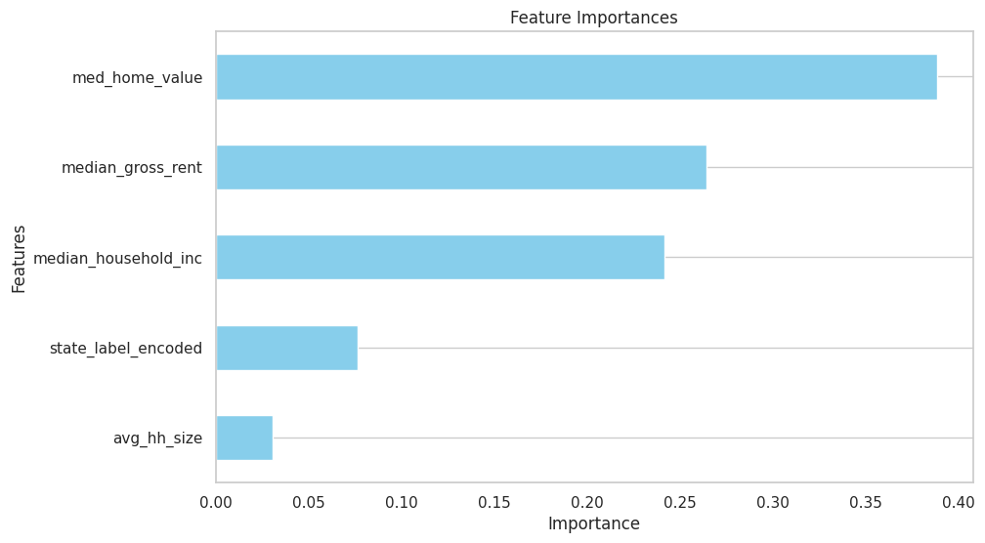
Feature Importance
Top Predictors:
Median Home Value
Median Gross Rent
Household Income
Business Interpretation:
Areas with rising income and rent tend to have
higher property growth potential.
State-level economic factors also play a role.

Slide 7
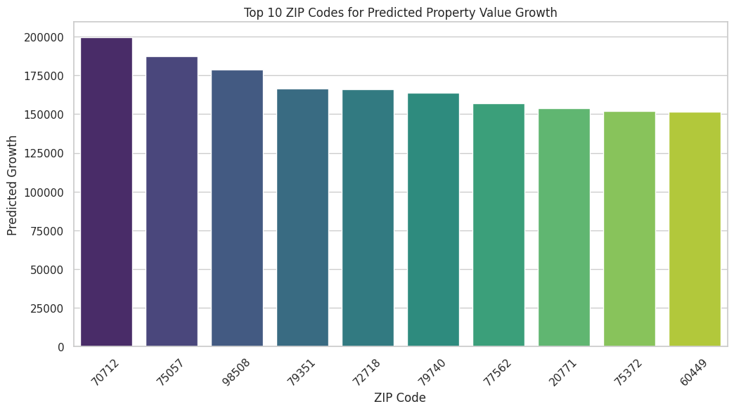
Top 10 ZIP Codes for Investment
Predicted Growth:
Based on model forecasts for 2016–2017.
ZIP codes with the highest property
value growth potential.

Slide 8
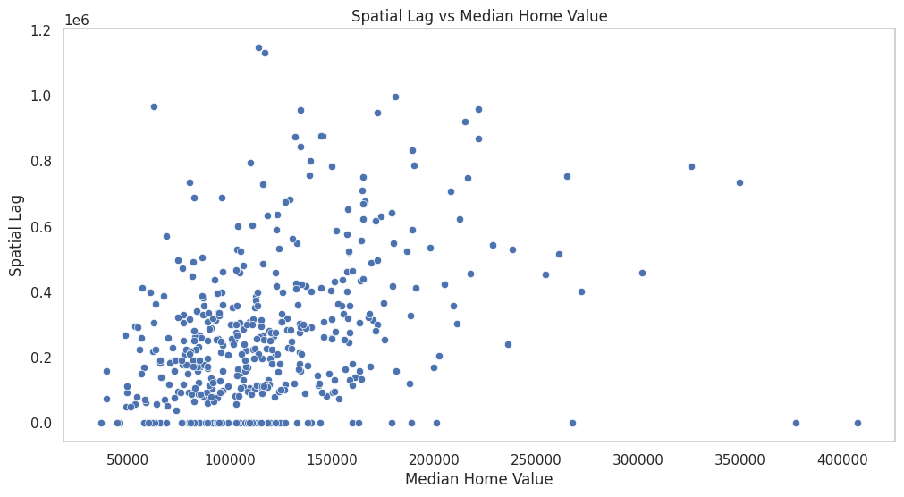
Geospatial Analysis - Key Findings
Spatial Lag Effect:
Strong correlation between a ZIP code’s property value and its neighboring ZIP codes.
Confirmed using Moran’s I statistic (indicates clustering).

Slide 9
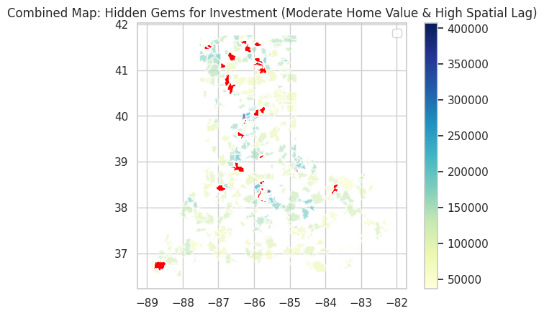
Hidden Gems for Investment
Definition of Hidden Gems:
ZIP codes with moderate current values but
high growth potential based on spatial influence.
Why They Matter:
Undervalued markets poised for rapid growth.
Perfect for early-stage investment opportunities.
Hidden Gem ZIP Codes: ['40213' '40214' '40217' '40219' '40505' '41041' '41095' '42066' '46011'
'46060' '46158' '46208' '46225' '46228' '46254' '46268' '46342' '46410'
'46506' '46510' '46526' '46534' '46580' '46614' '46923' '46962' '47126'
'47150' '47172' '47232' '47421' '47546' '47957' '47960']

Slide 10
Business Recommendations
Focus Investments
Prioritize the top 10 ZIP codes identified through predictive modeling.
Leverage Hidden Gems
Invest early in undervalued ZIP codes with high spatial lag influence.
Monitor Geospatial Trends
Regularly reassess using updated data to capture emerging opportunities.

Slide 11
Future Work
Model Enhancements:
Integrate macroeconomic data (interest rates, employment stats).
Explore deep learning models for improved accuracy.
Advanced Geospatial Analysis:
Incorporate real-time data (housing permits, infrastructure projects).
Use dynamic spatial models for continuous updates.

Slide 12
Conclusion & Next Steps
Data-driven approach supports strategic, high-return investments.
Geospatial insights offer a competitive edge in identifying growth areas.
Next Step: Operationalize the model and integrate with business decision workflows.

